Slide 1
F5 Fiberbundle HDF5
Werner Benger
Center for Computation & Technology
Louisiana State University
http://sciviz.cct.lsu.edu/

Slide 2
Abstract
“The proper abstractions for scientific data are known. We just have to use them.” (D. M. Butler & S. Bryson, 1992): There is no common standard or agreement on file formats for scientific data, but there could be. The inductive approach common in software development usually leads to “special solutions for special problems” which are extended on a case by case basis. Consequently, each application develops their own approach of describing data, ultimately leading to incompatibilities in the file formats associated with these applications and groups of applications. In contrast, the deductive approach to describe data based on the theory of fiber bundles leads to a generalized way of describing scientific data independent of a particular scientific domain or application as it exhibits the mathematical abstractions that are common across disciplines.
This presentation will review the “F5” approach of modeling data for scientific visualization using fiber bundles on top of HDF5 as underlying I/O layer. The F5 model has originally been developed about 12 years ago in the context of numerical relativity simulation data as produced by Cactus, for handling both primary simulation (uniform grids, adaptive meshes, curvilinear grids, multipatch data…) and secondary post-processing data (surfaces, lines, particle sets, …). The formalism and implementation itself is independent of Cactus and has since been applied to other domains such as medical imaging, computational fluid dynamics (CFD), smoothed particle hydrodynamics (SPH) and geoscience data, easing scientific visualization through this common denominator. The presentation will provide a short review of the basic concepts and provide an in-depth discussion on how the F5 model describes various common and less common data types.

Slide 3
Overview
The Problem
Mathematics for Visualization
The Fiber Bundle data model
HDF5
Mapping the Fiber Bundle model to HDF5
Basics
Extensions
F5 API

Slide 4
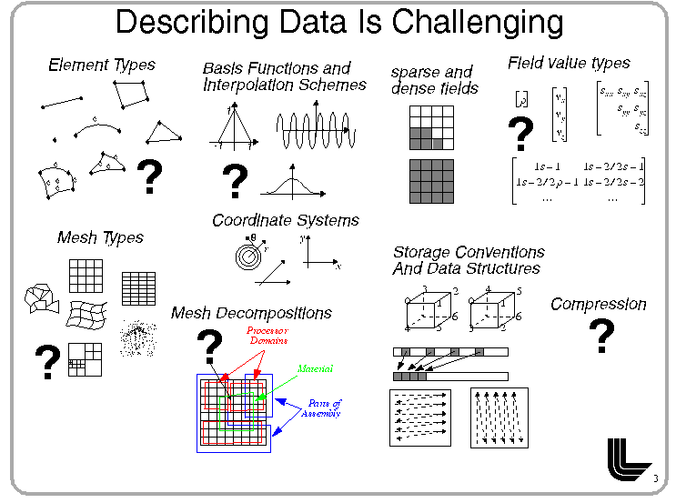
Thanks to Mark Miller, LLNL

Slide 5
Data Types
Point Sets
Unstructured Cell Data
Tetrahedral Grids
Regular Grids
Uniform Grids
Uniform Cartesian Grids
Uniform Polar Grids
…
Triangular Surfaces
Quad-based Surfaces
Irregular Surfaces
Hierarchical Grids (AMR)
Streamlines, Particle Trajectories, Geodesics
Apparent Horizons
Embedding Surfaces
…

Slide 6
“Special problems need special solutions”
Inductive approach in software engineering leads to incremental advances starting from a specific problem
Solutions often implemented on an enumerated case-by-cases basis
→ Results in many independent solutions

Slide 7
Interoperability?
Amira
AVS
Visit/Paraview
OpenDX
Vish

Slide 8
Data Model in SciViz
No commonly agreed data model exists for scientific visualization!
Data can not be shared among different visualization software!

Slide 9

Interoperability… wishful thinking
Amira
AVS
Visit/Paraview
OpenDX
Vish

Slide 10

Interoperability
N Applications
M File Formats
Visit
Scirun
Ensight
OpenDX
Amira
Diverse Visualization Software ↔ Data sets in diverse file formats
DICOM
Cactus
CGNS
NetCDF
GeoTIFF

Slide 11
N x M Implementation Effort
n applications, m file formats
Visit
Scirun
Ensight
OpenDX
Amira
DICOM
Cactus
CGNS
NetCDF
GeoTIFF

Slide 12

N + M Common Data Model
n sources, m sinks, 1 route
Visit
Scirun
Ensight
OpenDX
Amira
Common Data Model
DICOM
Cactus
CGNS
NetCDF
GeoTIFF

Slide 13
Commonalities of Grid types
Regular Grid
Uniform Grid
Rectilinear Grid
Curvilinear Grid

Slide 14
Hierarchy of Grid types
Regular Grid
Uniform Grid
Rectilinear Grid
Curvilinear Grid
Point Sets
Irregular Grids
Lines
Triangular Surfaces
Tetrahedral Grids

Slide 15
Challenge of a Common Data Model
“The proper abstractions for scientific data are known. We just have to use them.”
D. M. Butler & S. Bryson
Vector-Bundle Classes form Powerful Tool for Scientific Visualization
Computers in Physics, Vol. 6, No 6., Nov/Dec 1992

Slide 16
Motivation
Elegant mathematical formulations inspire visualization methods to become
More general
Wider applicable
Better structured, more modular
Deductive Approach
Methods (I/O, numerical algorithms, visualization) are implemented with the broader context in mind

Slide 17
Mathematics for Visualization
Topology
Discretization schemes, combinatorial structure, relational information
Differential Geometry
Coordinate representations, transformations, differential operators, tensor algebra
Geometric Algebra
N-dimensional Rotations, navigation, data analysis, feature extraction, spinor formalism, generalized quaternions, mimetic operators

Slide 18
Topology
Concept of fiber bundles
Concept of cw-complexes and k-Skeletons
Relational Information

Slide 19
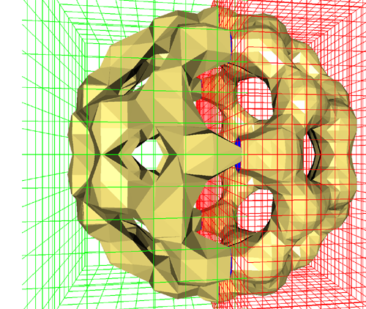
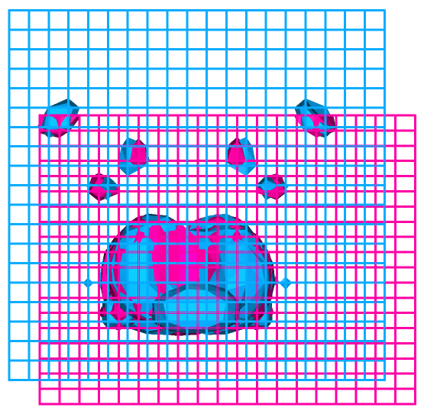
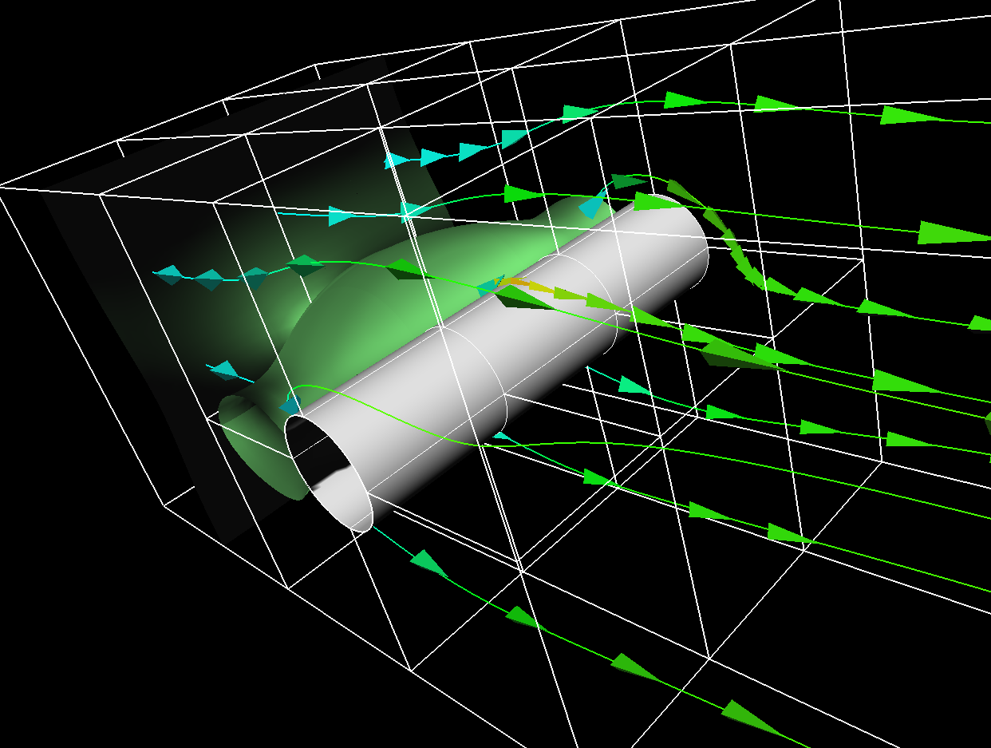
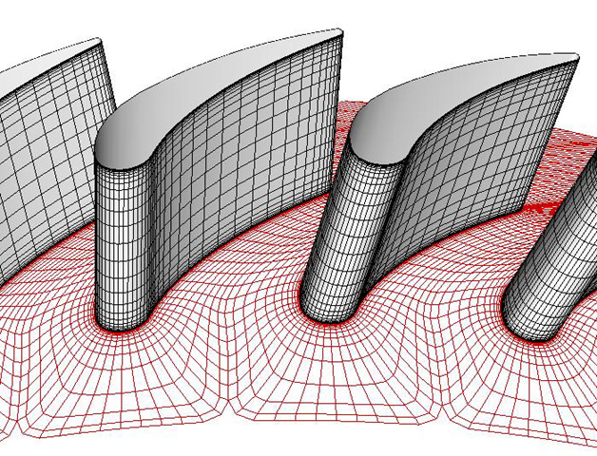
Fiber Bundles: Unification of data types

Slide 20
Mathematical Definition
Let E, B be topological spaces and f : E → B a continuous map.
(E,B,f) is called a (fiber) bundle if there exists a space F such that the union of fibers of a neighborhood U_{b}⊂B of each point b∈B are homeomorphic to U_{b}×F such that the projection pr₁ of U_{b} × F is U_{b} again.

Slide 21
Naming
E is called the total space E,
B is called the base space,
f : E → B the projection map.
The space F is called the fiber of the bundle.
(E,B,f: E→B) bundle ⇔∃F : ∀b∈B : ∃U_{b}⊂B : f⁻¹ (U_{b}) ≃ U_{b}×F
and pr₁(U_{b} × F) = U_{b}

Slide 22
A Fiber Bundle Homeomorphism

Slide 23
A Non-Fiber Bundle Homeomorphism

Slide 24
Fiber Bundle Data Model
Is a generic approach to handle a wide range of data types used for scientific visualization
Basic concept: Base space maps to fibers
Fiber Space at each
point of Base Space
Base Space

Slide 25
Total Space for Data in SciViz
Discretized
Neighborhood, Connectivity, k-Skeletons
Described via integer-valued arrays referring to indices
Numerical values are intrinsic, no dependence on coordinate system
Continuous
Scalar, vector, tensor fields
Described via float point numbers
Numerical value depends on representation (coordinate system)
Exception: true scalar fields
Base Space
Fiber Space

Slide 26
“F5 Fiber Bundle Data Model”
A property-based description of scientific data
A specific data type is built from “construction blocks” (not enumerated case lists)
Does not answer the question “what is it?” but answers the question(s) “how is it?”
A specific data set can have properties of many data types
non-exclusive properties
eases/enhances interoperability
Enables abstract operations independent of data type

Slide 27
The F5 Fiber Bundle Data Model
Casts data into hierarchy:
Field
Representation
Skeleton
Grid object
(Time) Slice
Bundle
Field
Coordinates
Vertices
Grid
T=0.0
Fiber Bundle

Slide 28
Lowest Level: Fiber Bundle over a Parameter Space
Similar to 3+1 Decomposition in Numerical Relativity
Field
Representation
Skeleton
Grid object
(Time) Slice
Bundle
Time
Field
Coordinates
T=0.8
Vertices
Grid
T=0.4
Fiber Bundle
T=0.0
T=0.4
T=0.8
T=0.0

Slide 29

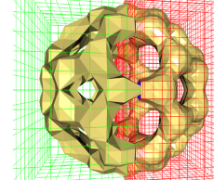
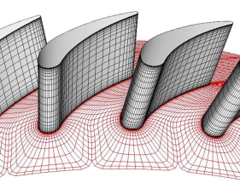
Grid: A geometric entity
Field
Representation
Skeleton
Grid object
(Time) Slice
Bundle
Field
Coordinates
Vertices
Grid
T=0.0
Fiber Bundle

Slide 30
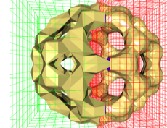
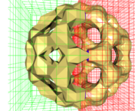
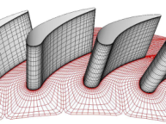
Grid Objects as Fibers of a two-dimensional Parameter Space
Evolutions and Identifiers
Time
Fiber Bundle
T=0.8
Grid Identifier
T=0.4
T=0.0

Slide 31
Grid Iterations
Iterate over 1st dimension “time”:
Find all Grid objects that exist for a specific instance of (physical) time or time interval
Iteration by physical time, not “time-step”
Iterate over 2nd dimension “Grid ID”
Find all times for which a Grid exists
Temporal evolution of a Grid and its data
Allows to trace features in Grid objects
Generalization of one-dimensional “time” to higher-dimensional parameter spaces possible
→ Easy synchronization of distinct data sources
Compare an ensemble of simulations

Slide 32
Structure of a Grid Object
Consider discrete base space:
Definition “k-cell”
Definition “incident”
Definition “adjacent”
Definition “n-Skeleton”
Definition “CW-Complex”

Slide 33
Topology: cw-Complex
Discretized n-dimensional Manifold
Concept of k-cells with adjacency
Hierarchy of k-Skeletons, k=0…N
0-cell: Vertices 1-cell: Edges 2-cell: Faces 3-cell: simplexes

Slide 34
Definition “incident”
Two cells c₁, c₂ are incident if c₁ ⊆ ∂c₂, where ∂c₂ denotes the border of the cell c₂.
Two cells of the same dimension can never be incident because dim(c₁) ≠ dim(c₂) for two incident cells c₁, c₂.
c₁ is a side of c₂ if dim(c₁) < dim(c₂), which may be written as c₁ < c₂.

Slide 35
Definition: “adjacent”
Two k−cells c₁, c₂ with k > 0 are called adjacent if they have a common side, i.e.
cell c₁, c₂ adjacent ⇔ ∃ cell f : f<c₁ , f<c₂ .
For k = 0 two 0-cells (i.e. vertices) v₁, v₂ are said to be adjacent if there exists a 1-cell (edge) ℮ which contains both, i.e. v₁ < ℮ and v₂ < ℮.

Slide 36
Formal Definition: Skeleton
A decomposition of a Hausdorff space X, is a hierarchical system of spaces X⁽⁻¹⁾ ⊆ X⁽⁰⁾ ⊆ X⁽¹⁾ ⊆ … ⊆ X^{(n)}, constructed by pairwise disjoint open cells c ⊂ X with the Hausdorff topology, such that X^{(n)} is obtained from X^{(n−1)} by attaching adjacent n-cells to each (n − 1)-cell and X⁽⁻¹⁾ = ∅.
The respective subspaces X^{(n)} are called the n-skeletons of X.

Slide 37
CW-Complex
A decomposition is also called a CW-complex.
It can be understood as a set of cells which is glued together at their subcells.
It is a generalization of the concept of a graph by adding cells of dimension greater than 1.

Slide 38
Topology: k-Skeletons
Field
Representation
Skeleton
Grid object
(Time) Slice
Bundle
Field
Coordinates
Edges
Vertices
Faces
Grid
T=0.0
Fiber Bundle

Slide 39
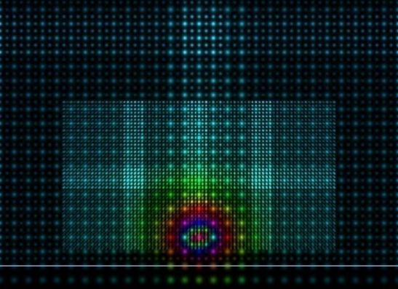
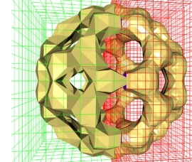

Extended Skeletons
Refinement Levels
Multiresolution, Adaptive Mesh Refinement
Cell Complex
Blocks, fragments
Topological Relationships
Grid future/past
Intergrid Relationships

Slide 40
Differential Geometry
Concept of a manifold and charts
Cartesian
Coordinates
Data
Spherical
Coordinates

Slide 41
Structure of the Fiber Space
May carry
Scalar fields
Vector fields
Covector fields
Tensor fields
Pseudo-scalars
Multi-Vectors
Non-tensorial geometrical objects (e.g., Christoffel symbols)

Slide 42
Special cases of fiber space
Has vector space property:
E.g. contains vectors, tensors:
→ Vector Bundle
Is the tangent space of a manifold M:
→ Tangent Bundle M × T(M)

Slide 43
Representation
Numerical representation via coordinates:
A manifold M is an Hausdorff space with (local!) maps x:M→ℝ^{n}.
x={x⁰,x¹,x²…x^{n-1}} is called a chart
x^{m}:M→ℝ^{n} the m^{th} coordinate function
A chart in the base manifold M induces a coordinate basis in the tangential space.

Slide 44
Multiple Representations
Field
Representation
Skeleton
Grid object
(Time) Slice
Bundle
Field
Coordinates
Vertices
Grid
T=0.0
Fiber Bundle

Slide 45
Geometric Algebra: Vectors, Tensors, Spinors, …
Field
Representation
Skeleton
Grid object
(Time) Slice
Bundle
Field
Coordinates
Vertices
Grid
T=0.0
Fiber Bundle

Slide 46
Access via Parameters
Field
Fieldname
Cartesian
Coordinates
Vertices
Coordinate system
Grid
Topological property
T=0.0
Gridname
Fiber Bundle
Time

Slide 47
Grids and Fields
End-user operates only on Grid objects and Fields
Temperature
Density
Pressure
Velocity
Energy

Slide 48
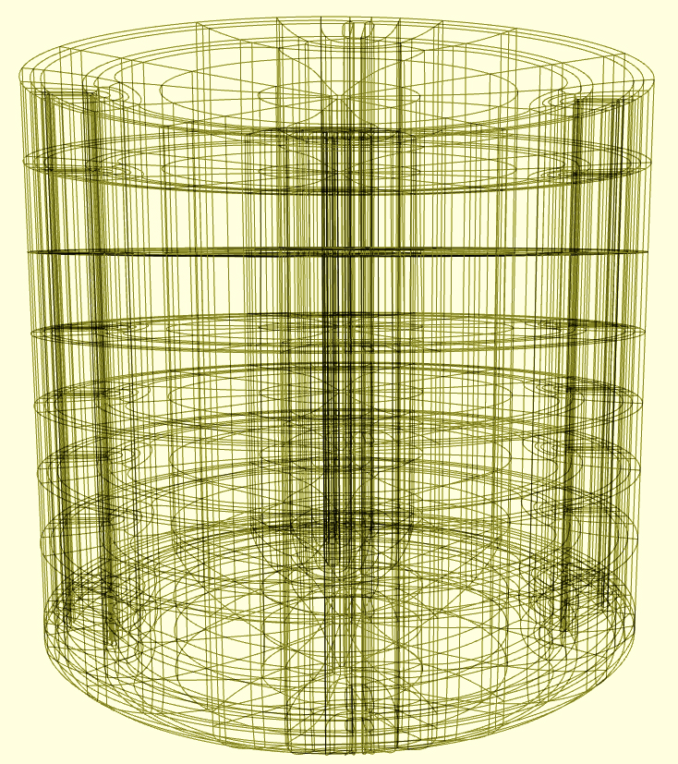
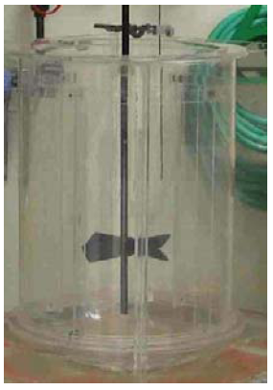
Application Example: Multiblock Curvilinear Data
The Stirtank Dataset
2088 curvilinear blocks
5000 time steps
Vectorfield describing velocity
Scalarfield describing pressure
500GB Binary Data

Slide 49
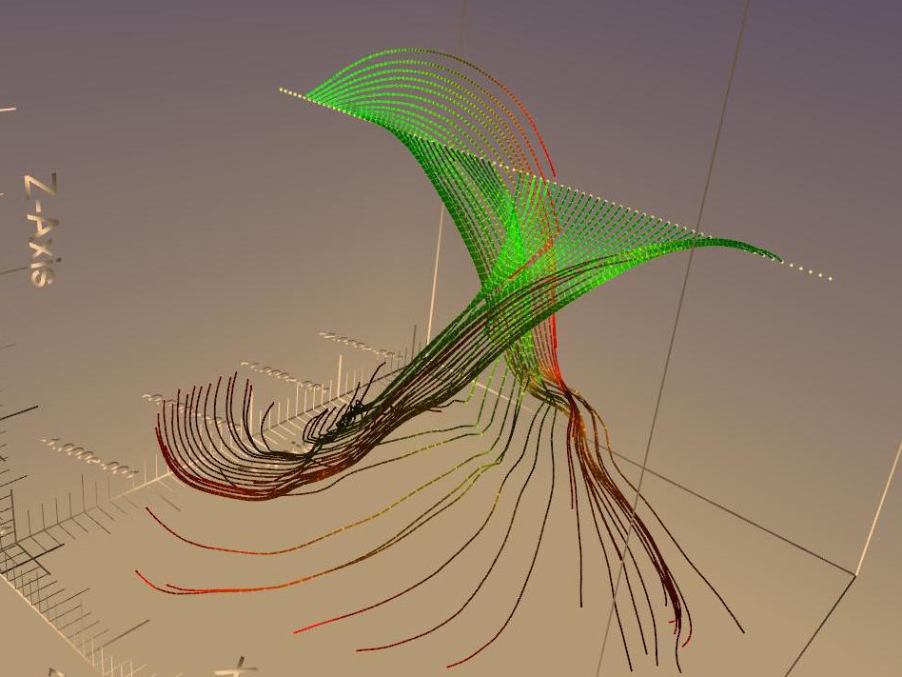
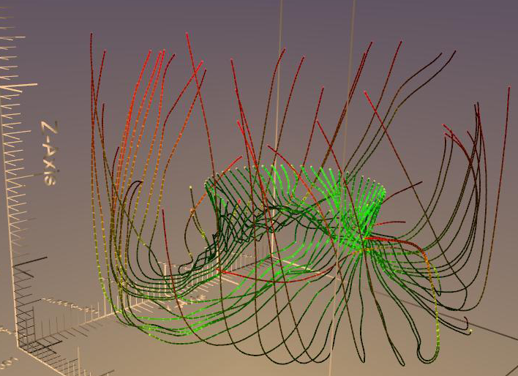
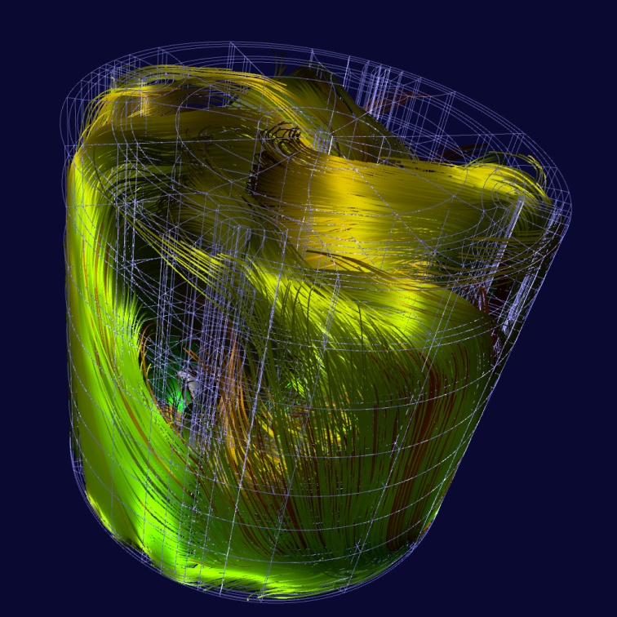
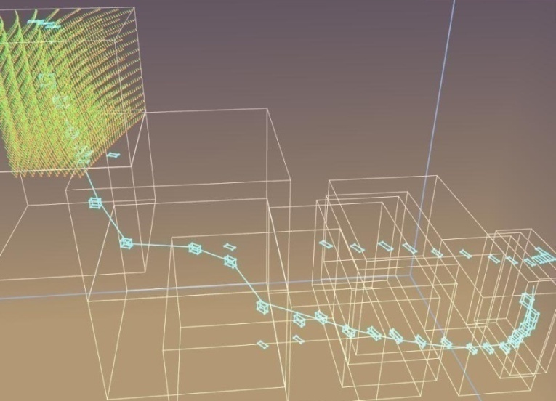
Streamlines

Slide 50
Streamlines in the Fiber Bundle
Model all Data within the
Fiber Bundle Model
→ Grid objects, Field objects
Seed Points
In: Grid
Streamlines
Computation
Vector Field
In: Field
Out: Grid
Set of Lines

Slide 51
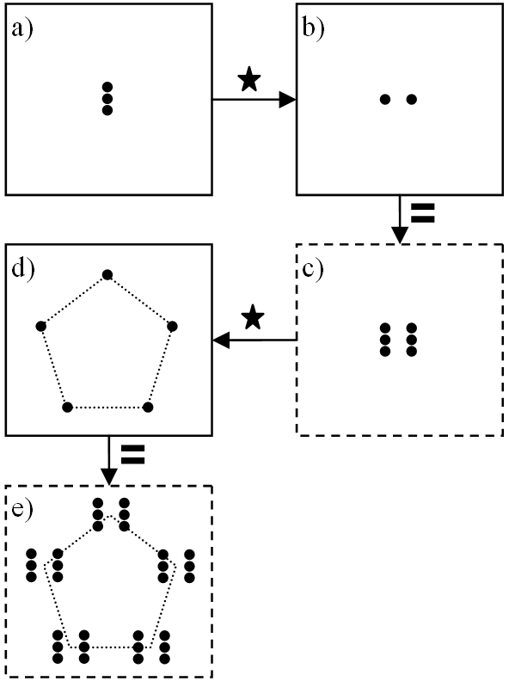
“Convolution” of Grids
Replicate Grid by points on another Grid
Seed Points
Point
Distribution
In: Grid
Grid
Convolver
In: Grid
Out: Grid
Marcel Ritter, 2006

Slide 52
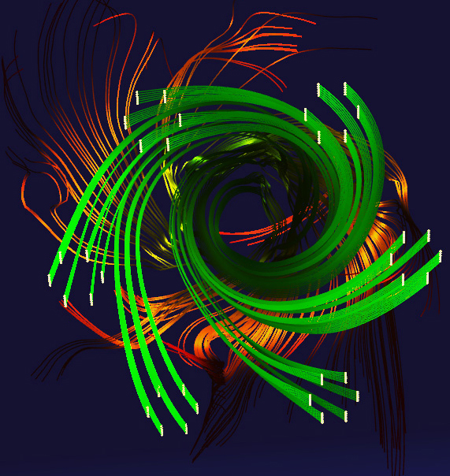
Systematic Approach
Input - Grid
Grid objects and Fields as entities within a visualization environment
Out: Grid
In: Grid
F5 Data
Bundle
Grid Convolver
Out: Grid
In: Grid
In: Bundle
Grid Convolver
Grid Selector
Out: Grid
Out: Grid
…
In: Grid
Vector Field
In: Grid
Streamlines
Computation
Out: Field
In: Field
Out: Grid
In: Grid
Line Renderer

Slide 53
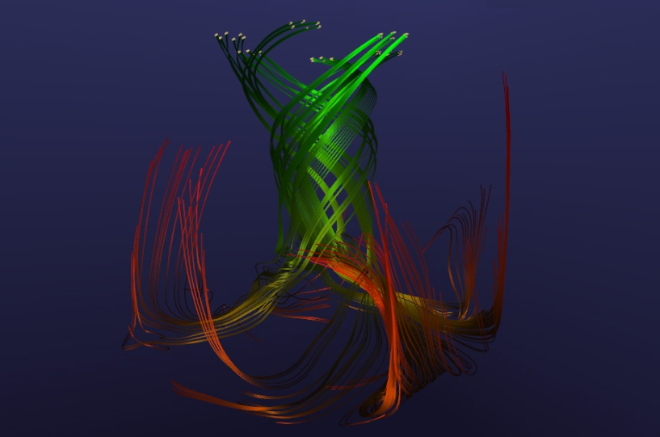
Systematic Approach
Input - Grid
Grid objects and Fields as entities within a visualization environment
Out: Grid
In: Grid
F5 Data
Bundle
Grid Convolver
Out: Grid
In: Grid
In: Bundle
Grid Convolver
Grid Selector
Out: Grid
Out: Grid
…
In: Grid
Vector Field
In: Grid
Streamlines
Computation
Out: Field
In: Field
Out: Grid
In: Grid
Line Renderer

Slide 54
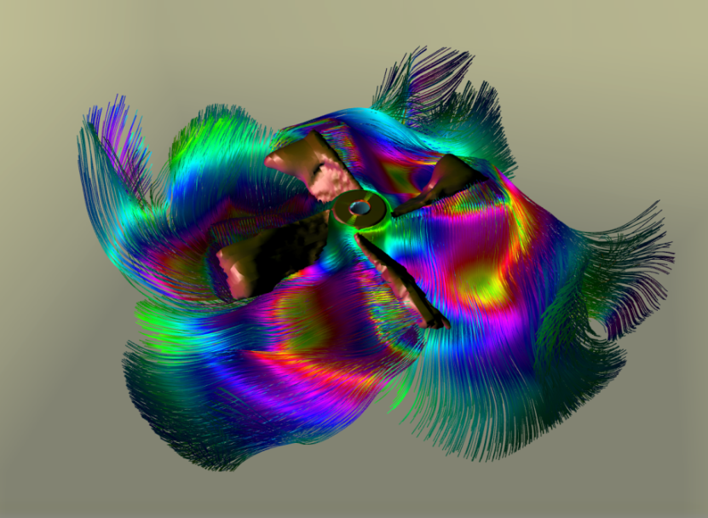
Systematic Approach
Seeding Streamlines from an Isosurface
F5 Data
Bundle
In: Grid
Scalar Field
Out: Field
In: Bundle
In: Field
Grid Selector
Isosurface
Out: Grid
Out: Grid
In: Grid
Vector Field
In: Grid
Streamlines
Computation
Out: Field
In: Field
Out: Grid
In: Grid
Line Renderer

Slide 55
F5 – Fiber Bundle HDF5
F5 as file format and I/O library

Slide 56
HDF = Hierarchical Data Format
HDF5 is the second HDF format
Development started in 1996
First release was in 1998
http://www.hdfgroup.org
Designed for HPC simulations
High-performance, large data, long-term data preservation (archival), portability
F5:Casting Fiber Bundle Data Model into HDF5

Slide 57
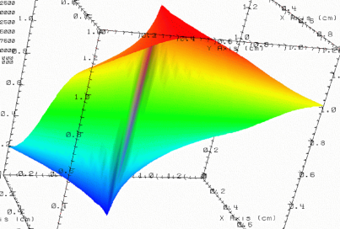


HDF5 File
lat | lon | temp
----|-----|-----
12 | 23 | 3.1
15 | 24 | 4.2
17 | 21 | 3.6
An HDF5 file is a container that holds data objects.
Experiment Notes:
Serial Number: 99378920
Date: 3/13/09
Configuration: Standard 3

Slide 58
Structures to organize objects
“Groups”
“/” (root)
3-D array
“/foo”
lat | lon | temp
----|-----|-----
12 | 23 | 3.1
15 | 24 | 4.2
17 | 21 | 3.6
palette
Table
Raster image
Raster image
2-D array
“Datasets”
Notes:
This shows that you can mix objects of different types according to your needs. Typically, there will be metadata stored with objects to indicate what type of object they are.
Like HDF4, HDF5 has a grouping structure. The main difference is that every HDF5 file starts with a root group, whereas HDF4 doesn’t need any groups at all.

Slide 59



HDF5 Groups and Links
/
HDF5 groups and links organize data objects.
Experiment Notes:
Serial Number: 99378920
Date: 3/13/09
Configuration: Standard 3
Viz
SimOut
lat | lon | temp
----|-----|-----
12 | 23 | 3.1
15 | 24 | 4.2
17 | 21 | 3.6

Slide 60
Path to HDF5 object in a file
/ (root)
/X
/Y
/Y/temp
/Y/bar/temp
Y
“/”
X
temp
bar
temp
Notes:
Like HDF4, HDF5 has a grouping structure.
The main difference is that every HDF5 file starts with a root group, whereas HDF4 doesn’t need any groups at all.

Slide 61
Example Dataset
The internal HDF5 file organisation made visible using the h5ls command: h5ls –rv file.h5
HDF5 allows easily to attach
names to the numerical values.
HDF5 takes care of endianess, double to float
conversion and different layouts, e.g.
{x,y,z} vs {z,x,y}
The naming scheme can also serve
to identify the coordinate system rel.
to which the numbers are stored
e.g. {x,y,z} vs {r, phi, theta}
/Block00001 Dataset {5/5, 13/13, 9/9}
Location: 1:15768
Links: 1
Storage: 7020 allocated bytes
Type: struct {
"x" +0 native float
"y" +4 native float
"z" +8 native float
} 12 bytes
Data:
(0,0,0) {0.210951, -0.0406732, 0.0611351},
{0.210204, -0.0443333, 0.0611199},
{0.209324, -0.0483009, 0.0611070},
{0.208286, -0.0525892, 0.0610958}
(0,0,4) {0.207065, -0.0571980, 0.0610863},
{0.205640, -0.0621138, 0.0610815},

Slide 62
HDF5 as a file system in a file
Group
Dataset
Size
Creation date
Dimensionality
Data type (int, float, …)
Symbolic Link
Attributes
Named data types
Mounting external data
Virtual File Driver (stdio, mpi-io, streaming VFD,…)
Directory, Folder
File
Size
Creation data
-
-
Symbolic Link, Shortcut
-
-
Mounting file systems
File system type (ext3, ntfs, nfs,…)
HDF5
File System

Slide 63
F5 File Format
Casting 6 hierarchy levels into HDF5
Field
Representation
Skeleton
Grid object
(Time) Slice
Bundle
Field
Coordinates
Vertices
Grid
T=0.0
Fiber Bundle

Slide 64
/Time/Grid/Top/Rep/Field/
h5ls -r minkowski-0000.f5
/T=0/minkowski/Points/StandardCartesianChart3D Group
/T=0/minkowski/Points/StandardCartesianChart3D/ADMBASE::CURV Group
/T=0/minkowski/Points/StandardCartesianChart3D/ADMBASE::CURV/gxx Dataset {43, 37, 19}
/T=0/minkowski/Points/StandardCartesianChart3D/ADMBASE::CURV/gxy Dataset {43, 37, 19}
/T=0/minkowski/Points/StandardCartesianChart3D/ADMBASE::CURV/gxz Dataset {43, 37, 19}
/T=0/minkowski/Points/StandardCartesianChart3D/ADMBASE::CURV/gyy Dataset {43, 37, 19}
/T=0/minkowski/Points/StandardCartesianChart3D/ADMBASE::CURV/gyz Dataset {43, 37, 19}
/T=0/minkowski/Points/StandardCartesianChart3D/ADMBASE::CURV/gzz Dataset {43, 37, 19}
/T=0/minkowski/Points/StandardCartesianChart3D/ADMBASE::LAPSE Dataset {43, 37, 19}
/T=0/minkowski/Points/StandardCartesianChart3D/ADMBASE::METRIC Group
/T=0/minkowski/Points/StandardCartesianChart3D/ADMBASE::METRIC/gxx Dataset {43, 37, 19}
/T=0/minkowski/Points/StandardCartesianChart3D/ADMBASE::METRIC/gxy Dataset {43, 37, 19}
/T=0/minkowski/Points/StandardCartesianChart3D/ADMBASE::METRIC/gxz Dataset {43, 37, 19}
/T=0/minkowski/Points/StandardCartesianChart3D/ADMBASE::METRIC/gyy Dataset {43, 37, 19}
/T=0/minkowski/Points/StandardCartesianChart3D/ADMBASE::METRIC/gyz Dataset {43, 37, 19}
/T=0/minkowski/Points/StandardCartesianChart3D/ADMBASE::METRIC/gzz Dataset {43, 37, 19}
/T=0/minkowski/Points/StandardCartesianChart3D/Positions Group
/T=0.119047619047619041010577234374 Group
/T=0.119047619047619041010577234374/minkowski Group

Slide 65
F5 Hierarchy in HDF5
Time Slices (parameter space)
Grid (geometrical entity)
Topology → n-Skeletons
Representation (coordinate systems,
Field (denotes data sets)
Field fragments (denotes data layout)
Compound component (alternative layout for compound data)

Slide 66
/Time/Grid/Top/Rep/Field/Fragment
Slicing of a spacetime
Bundles all entities that belong to a certain physical time
Encompasses all information that might relates to a certain time
May contain multiple geometries
Constraints on HDF5 file:
No datasets contained on this level
Group must have floating-point attribute “time”

Slide 67
Example: h5ls -r
h5ls -r minkowski-0000.f5
/T=0/minkowski/Points/StandardCartesianChart3D Group
/T=0/minkowski/Points/StandardCartesianChart3D/ADMBASE::CURV Group
/T=0/minkowski/Points/StandardCartesianChart3D/ADMBASE::CURV/gxx Dataset {43, 37, 19}
/T=0/minkowski/Points/StandardCartesianChart3D/ADMBASE::CURV/gxy Dataset {43, 37, 19}
/T=0/minkowski/Points/StandardCartesianChart3D/ADMBASE::CURV/gxz Dataset {43, 37, 19}
/T=0/minkowski/Points/StandardCartesianChart3D/ADMBASE::CURV/gyy Dataset {43, 37, 19}
/T=0/minkowski/Points/StandardCartesianChart3D/ADMBASE::CURV/gyz Dataset {43, 37, 19}
/T=0/minkowski/Points/StandardCartesianChart3D/ADMBASE::CURV/gzz Dataset {43, 37, 19}
/T=0/minkowski/Points/StandardCartesianChart3D/ADMBASE::LAPSE Dataset {43, 37, 19}
/T=0/minkowski/Points/StandardCartesianChart3D/ADMBASE::METRIC Group
/T=0/minkowski/Points/StandardCartesianChart3D/ADMBASE::METRIC/gxx Dataset {43, 37, 19}
/T=0/minkowski/Points/StandardCartesianChart3D/ADMBASE::METRIC/gxy Dataset {43, 37, 19}
/T=0/minkowski/Points/StandardCartesianChart3D/ADMBASE::METRIC/gxz Dataset {43, 37, 19}
/T=0/minkowski/Points/StandardCartesianChart3D/ADMBASE::METRIC/gyy Dataset {43, 37, 19}
/T=0/minkowski/Points/StandardCartesianChart3D/ADMBASE::METRIC/gyz Dataset {43, 37, 19}
/T=0/minkowski/Points/StandardCartesianChart3D/ADMBASE::METRIC/gzz Dataset {43, 37, 19}
/T=0/minkowski/Points/StandardCartesianChart3D/Positions Group
/T=0/minkowski/Points/StandardCartesianChart3D/STATICCONFORMAL::CONFAC Dataset {43, 37, 19}
/T=0/minkowski/Points/StandardCartesianChart3D/STATICCONFORMAL::CONFAC_1DERIVS Group
/T=0/minkowski/Points/StandardCartesianChart3D/STATICCONFORMAL::CONFAC_1DERIVS/Dx Dataset {43, 37, 19}
/T=0/minkowski/Points/StandardCartesianChart3D/STATICCONFORMAL::CONFAC_1DERIVS/Dy Dataset {43, 37, 19}
/T=0/minkowski/Points/StandardCartesianChart3D/STATICCONFORMAL::CONFAC_1DERIVS/Dz Dataset {43, 37, 19}
/T=0.119047619047619041010577234374 Group
/T=0.119047619047619041010577234374/minkowski Group

Slide 68
/Time/Grid/Top/Rep/Field/Fragment
Description of a geometrical entity
Bundles all properties that belong to a certain object
Encompasses all information that is or might be required to perform operations on the certain object
… is a spatial manifold (or topological space) plus fiber space
Constraints on HDF5 file:
No datasets contained on this level
Group must have at least one subgroup fulfilling the constraints of a “Vertex Skeleton”

Slide 69
Example: h5ls -r
h5ls -r minkowski-0000.f5
/T=0/minkowski/Points/StandardCartesianChart3D Group
/T=0/minkowski/Points/StandardCartesianChart3D/ADMBASE::CURV Group
/T=0/minkowski/Points/StandardCartesianChart3D/ADMBASE::CURV/gxx Dataset {43, 37, 19}
/T=0/minkowski/Points/StandardCartesianChart3D/ADMBASE::CURV/gxy Dataset {43, 37, 19}
/T=0/minkowski/Points/StandardCartesianChart3D/ADMBASE::CURV/gxz Dataset {43, 37, 19}
/T=0/minkowski/Points/StandardCartesianChart3D/ADMBASE::CURV/gyy Dataset {43, 37, 19}
/T=0/minkowski/Points/StandardCartesianChart3D/ADMBASE::CURV/gyz Dataset {43, 37, 19}
/T=0/minkowski/Points/StandardCartesianChart3D/ADMBASE::CURV/gzz Dataset {43, 37, 19}
/T=0/minkowski/Points/StandardCartesianChart3D/ADMBASE::LAPSE Dataset {43, 37, 19}
/T=0/minkowski/Points/StandardCartesianChart3D/ADMBASE::METRIC Group
/T=0/minkowski/Points/StandardCartesianChart3D/ADMBASE::METRIC/gxx Dataset {43, 37, 19}
/T=0/minkowski/Points/StandardCartesianChart3D/ADMBASE::METRIC/gxy Dataset {43, 37, 19}
/T=0/minkowski/Points/StandardCartesianChart3D/ADMBASE::METRIC/gxz Dataset {43, 37, 19}
/T=0/minkowski/Points/StandardCartesianChart3D/ADMBASE::METRIC/gyy Dataset {43, 37, 19}
/T=0/minkowski/Points/StandardCartesianChart3D/ADMBASE::METRIC/gyz Dataset {43, 37, 19}
/T=0/minkowski/Points/StandardCartesianChart3D/ADMBASE::METRIC/gzz Dataset {43, 37, 19}
/T=0/minkowski/Points/StandardCartesianChart3D/Positions Group
/T=0/minkowski/Points/StandardCartesianChart3D/STATICCONFORMAL::CONFAC Dataset {43, 37, 19}
/T=0/minkowski/Points/StandardCartesianChart3D/STATICCONFORMAL::CONFAC_1DERIVS Group
/T=0/minkowski/Points/StandardCartesianChart3D/STATICCONFORMAL::CONFAC_1DERIVS/Dx Dataset {43, 37, 19}
/T=0/minkowski/Points/StandardCartesianChart3D/STATICCONFORMAL::CONFAC_1DERIVS/Dy Dataset {43, 37, 19}
/T=0/minkowski/Points/StandardCartesianChart3D/STATICCONFORMAL::CONFAC_1DERIVS/Dz Dataset {43, 37, 19}
/T=0.119047619047619041010577234374 Group
/T=0.119047619047619041010577234374/minkowski Group

Slide 70
/Time/Grid/Top/Rep/Field/Fragment
Topological properties of a Grid
One entry for each k-Skeleton:
Vertices, Edges, Faces, Cells
Contains Index spaces:
Discrete sets with properties
Color per vertex, color per face, color per cell
Cell Complexes: sets of cells
Constraints on HDF5 file:
Attribute “index depth”
All datasets in this group or below must have same number of elements and dimensionality
Optional attribute “refinement”

Slide 71
Example: h5ls -r
h5ls -r minkowski-0000.f5
/T=0/minkowski/Points/StandardCartesianChart3D Group
/T=0/minkowski/Points/StandardCartesianChart3D/ADMBASE::CURV Group
/T=0/minkowski/Points/StandardCartesianChart3D/ADMBASE::CURV/gxx Dataset {43, 37, 19}
/T=0/minkowski/Points/StandardCartesianChart3D/ADMBASE::CURV/gxy Dataset {43, 37, 19}
/T=0/minkowski/Points/StandardCartesianChart3D/ADMBASE::CURV/gxz Dataset {43, 37, 19}
/T=0/minkowski/Points/StandardCartesianChart3D/ADMBASE::CURV/gyy Dataset {43, 37, 19}
/T=0/minkowski/Points/StandardCartesianChart3D/ADMBASE::CURV/gyz Dataset {43, 37, 19}
/T=0/minkowski/Points/StandardCartesianChart3D/ADMBASE::CURV/gzz Dataset {43, 37, 19}
/T=0/minkowski/Points/StandardCartesianChart3D/ADMBASE::LAPSE Dataset {43, 37, 19}
/T=0/minkowski/Points/StandardCartesianChart3D/ADMBASE::METRIC Group
/T=0/minkowski/Points/StandardCartesianChart3D/ADMBASE::METRIC/gxx Dataset {43, 37, 19}
/T=0/minkowski/Points/StandardCartesianChart3D/ADMBASE::METRIC/gxy Dataset {43, 37, 19}
/T=0/minkowski/Points/StandardCartesianChart3D/ADMBASE::METRIC/gxz Dataset {43, 37, 19}
/T=0/minkowski/Points/StandardCartesianChart3D/ADMBASE::METRIC/gyy Dataset {43, 37, 19}
/T=0/minkowski/Points/StandardCartesianChart3D/ADMBASE::METRIC/gyz Dataset {43, 37, 19}
/T=0/minkowski/Points/StandardCartesianChart3D/ADMBASE::METRIC/gzz Dataset {43, 37, 19}
/T=0/minkowski/Points/StandardCartesianChart3D/Positions Group
/T=0/minkowski/Points/StandardCartesianChart3D/STATICCONFORMAL::CONFAC Dataset {43, 37, 19}
/T=0/minkowski/Points/StandardCartesianChart3D/STATICCONFORMAL::CONFAC_1DERIVS Group
/T=0/minkowski/Points/StandardCartesianChart3D/STATICCONFORMAL::CONFAC_1DERIVS/Dx Dataset {43, 37, 19}
/T=0/minkowski/Points/StandardCartesianChart3D/STATICCONFORMAL::CONFAC_1DERIVS/Dy Dataset {43, 37, 19}
/T=0/minkowski/Points/StandardCartesianChart3D/STATICCONFORMAL::CONFAC_1DERIVS/Dz Dataset {43, 37, 19}
/T=0.119047619047619041010577234374 Group
/T=0.119047619047619041010577234374/minkowski Group

Slide 72
/Time/Grid/Top/Rep/Field/Fragment
Representation of Skeleton relative to “something”, e.g.:
Charts (coordinate systems)
N-Skeletons (cells as vertices, faces as vertices, vertices as cells)
Cell complexes (cells per complex, complexes per cell)
Another Grid (interpolation weight)
Constraints on HDF5 file:
The name of the group must refer to an existing entity, such as a coordinate system identifier or another Skeleton group

Slide 73
Example: h5ls -r
h5ls -r minkowski-0000.f5
/T=0/minkowski/Points/StandardCartesianChart3D Group
/T=0/minkowski/Points/StandardCartesianChart3D/ADMBASE::CURV Group
/T=0/minkowski/Points/StandardCartesianChart3D/ADMBASE::CURV/gxx Dataset {43, 37, 19}
/T=0/minkowski/Points/StandardCartesianChart3D/ADMBASE::CURV/gxy Dataset {43, 37, 19}
/T=0/minkowski/Points/StandardCartesianChart3D/ADMBASE::CURV/gxz Dataset {43, 37, 19}
/T=0/minkowski/Points/StandardCartesianChart3D/ADMBASE::CURV/gyy Dataset {43, 37, 19}
/T=0/minkowski/Points/StandardCartesianChart3D/ADMBASE::CURV/gyz Dataset {43, 37, 19}
/T=0/minkowski/Points/StandardCartesianChart3D/ADMBASE::CURV/gzz Dataset {43, 37, 19}
/T=0/minkowski/Points/StandardCartesianChart3D/ADMBASE::LAPSE Dataset {43, 37, 19}
/T=0/minkowski/Points/StandardCartesianChart3D/ADMBASE::METRIC Group
/T=0/minkowski/Points/StandardCartesianChart3D/ADMBASE::METRIC/gxx Dataset {43, 37, 19}
/T=0/minkowski/Points/StandardCartesianChart3D/ADMBASE::METRIC/gxy Dataset {43, 37, 19}
/T=0/minkowski/Points/StandardCartesianChart3D/ADMBASE::METRIC/gxz Dataset {43, 37, 19}
/T=0/minkowski/Points/StandardCartesianChart3D/ADMBASE::METRIC/gyy Dataset {43, 37, 19}
/T=0/minkowski/Points/StandardCartesianChart3D/ADMBASE::METRIC/gyz Dataset {43, 37, 19}
/T=0/minkowski/Points/StandardCartesianChart3D/ADMBASE::METRIC/gzz Dataset {43, 37, 19}
/T=0/minkowski/Points/StandardCartesianChart3D/Positions Group
/T=0/minkowski/Points/StandardCartesianChart3D/STATICCONFORMAL::CONFAC Dataset {43, 37, 19}
/T=0/minkowski/Points/StandardCartesianChart3D/STATICCONFORMAL::CONFAC_1DERIVS Group
/T=0/minkowski/Points/StandardCartesianChart3D/STATICCONFORMAL::CONFAC_1DERIVS/Dx Dataset {43, 37, 19}
/T=0/minkowski/Points/StandardCartesianChart3D/STATICCONFORMAL::CONFAC_1DERIVS/Dy Dataset {43, 37, 19}
/T=0/minkowski/Points/StandardCartesianChart3D/STATICCONFORMAL::CONFAC_1DERIVS/Dz Dataset {43, 37, 19}
/T=0.119047619047619041010577234374 Group
/T=0.119047619047619041010577234374/minkowski Group

Slide 74
/Time/Grid/Top/Rep/Field/Fragment
A set of numerical values
Positional information in the base space
Vertex coordinates or vertex indices per cell
Field data in the fiber space
Scalar, vector, tensor, …
Color per cell, color per vertex
Constraints on HDF5 file:
An entries may be n-dimensional dataset or a group; if it is a group, it needs to be identifiable as either
Fragmented field (contains sequence of n-dimensional datasets)
Compound data type with k separated components (contains k n-dimensional scalar-valued datasets)
Compound data type constructed as direct product of components (contains n one-dimensional scalar-valued datasets)
Linear field or polynomial expression

Slide 75
Procedural fields
Storage of field via group with attributes instead of dataset
Value per point computed procedurally on demand
Examples:
Equidistant coordinates (linear map of index to coordinate values)
Storage of compound data as separated components (XYZXYZ ←→ XXYYZZ)

Slide 76
Special Field Names
Reserved field name “Positions”
Stores coordinate locations
Coordinates in physical space
Cartesian,
Spherical
Cylindrical
Coordinates in index space
Vertex indices per cell
Edges per cell

Slide 77
Example: h5ls -r
h5ls -r minkowski-0000.f5
/T=0/minkowski/Points/StandardCartesianChart3D Group
/T=0/minkowski/Points/StandardCartesianChart3D/ADMBASE::CURV Group
/T=0/minkowski/Points/StandardCartesianChart3D/ADMBASE::CURV/gxx Dataset {43, 37, 19}
/T=0/minkowski/Points/StandardCartesianChart3D/ADMBASE::CURV/gxy Dataset {43, 37, 19}
/T=0/minkowski/Points/StandardCartesianChart3D/ADMBASE::CURV/gxz Dataset {43, 37, 19}
/T=0/minkowski/Points/StandardCartesianChart3D/ADMBASE::CURV/gyy Dataset {43, 37, 19}
/T=0/minkowski/Points/StandardCartesianChart3D/ADMBASE::CURV/gyz Dataset {43, 37, 19}
/T=0/minkowski/Points/StandardCartesianChart3D/ADMBASE::CURV/gzz Dataset {43, 37, 19}
/T=0/minkowski/Points/StandardCartesianChart3D/ADMBASE::LAPSE Dataset {43, 37, 19}
/T=0/minkowski/Points/StandardCartesianChart3D/ADMBASE::METRIC Group
/T=0/minkowski/Points/StandardCartesianChart3D/ADMBASE::METRIC/gxx Dataset {43, 37, 19}
/T=0/minkowski/Points/StandardCartesianChart3D/ADMBASE::METRIC/gxy Dataset {43, 37, 19}
/T=0/minkowski/Points/StandardCartesianChart3D/ADMBASE::METRIC/gxz Dataset {43, 37, 19}
/T=0/minkowski/Points/StandardCartesianChart3D/ADMBASE::METRIC/gyy Dataset {43, 37, 19}
/T=0/minkowski/Points/StandardCartesianChart3D/ADMBASE::METRIC/gyz Dataset {43, 37, 19}
/T=0/minkowski/Points/StandardCartesianChart3D/ADMBASE::METRIC/gzz Dataset {43, 37, 19}
/T=0/minkowski/Points/StandardCartesianChart3D/Positions Group
/T=0/minkowski/Points/StandardCartesianChart3D/STATICCONFORMAL::CONFAC Dataset {43, 37, 19}
/T=0/minkowski/Points/StandardCartesianChart3D/STATICCONFORMAL::CONFAC_1DERIVS Group
/T=0/minkowski/Points/StandardCartesianChart3D/STATICCONFORMAL::CONFAC_1DERIVS/Dx Dataset {43, 37, 19}
/T=0/minkowski/Points/StandardCartesianChart3D/STATICCONFORMAL::CONFAC_1DERIVS/Dy Dataset {43, 37, 19}
/T=0/minkowski/Points/StandardCartesianChart3D/STATICCONFORMAL::CONFAC_1DERIVS/Dz Dataset {43, 37, 19}
/T=0.119047619047619041010577234374 Group
/T=0.119047619047619041010577234374/minkowski Group

Slide 78
Multiple Coordinate Systems
/T=0/minkowski/Points/StandardCartesianChart3D Group
/T=0/minkowski/Points/StandardCartesianChart3D/Positions Group
/T=0/minkowski/Points/StandardCartesianChart3D/ADMBASE::METRIC Group
/T=0/minkowski/Points/StandardCartesianChart3D/ADMBASE::METRIC/gxx Dataset {43, 37, 19}
/T=0/minkowski/Points/StandardCartesianChart3D/ADMBASE::METRIC/gxy Dataset {43, 37, 19}
/T=0/minkowski/Points/StandardCartesianChart3D/ADMBASE::METRIC/gxz Dataset {43, 37, 19}
/T=0/minkowski/Points/StandardCartesianChart3D/ADMBASE::METRIC/gyy Dataset {43, 37, 19}
/T=0/minkowski/Points/StandardCartesianChart3D/ADMBASE::METRIC/gyz Dataset {43, 37, 19}
/T=0/minkowski/Points/StandardCartesianChart3D/ADMBASE::METRIC/gzz Dataset {43, 37, 19}
/T=0/minkowski/Points/SphericalChart3D Group
/T=0/minkowski/Points/SphericalChart3D/Positions Dataset {43, 37, 19}
/T=0/minkowski/Points/SphericalChart3D/ADMBASE::METRIC Group
/T=0/minkowski/Points/SphericalChart3D/ADMBASE::METRIC/grr Dataset {43, 37, 19}
/T=0/minkowski/Points/SphericalChart3D/ADMBASE::METRIC/grp Dataset {43, 37, 19}
/T=0/minkowski/Points/SphericalChart3D/ADMBASE::METRIC/grh Dataset {43, 37, 19}
/T=0/minkowski/Points/SphericalChart3D/ADMBASE::METRIC/gpp Dataset {43, 37, 19}
/T=0/minkowski/Points/SphericalChart3D/ADMBASE::METRIC/gph Dataset {43, 37, 19}
/T=0/minkowski/Points/SphericalChart3D/ADMBASE::METRIC/ghh Dataset {43, 37, 19}

Slide 79
/Time/Grid/Top/Rep/Field/Fragment
Internal memory layout of a field
Field may be stored
as contiguous block
as multiple sub-blocks (e.g. from domain decomposition)
Layout information may be shared among fragments
Coordinate location/boundaries of each fragment

Slide 80
Howto…
Specify relative information
Vertices per triangle, triangles per vertex, vertices per edge, edges per vertex, ..
Specify hierarchical meshes
Specify interpolation weights between grids
Define clusters of cells, edges, …
Trace time-dependent changes
Specify partially time-independent data

Slide 81
Concept of “Index Depth”
An integer property of an index space (Skeleton object), similar to dimensionality
Dimensionality: intrinsic property
Index depth: extrinsic property
Describes “how far” the index space is from the primary (mandatory) Vertex information of a Grid:
0 → Vertices
1 → Edges, Faces, Tetrahedrons, …
2 → Groups of edges, faces, tetrahedrons
3 → Groups of elements of index depth 2
4 → Groups of 3-elements
…

Slide 82
Relative Representations
Triangular Surface: 600331 Triangles, 314442 Points
Index Depth = 0
/T=1 Group
/T=1/adcirc Group
/T=1/adcirc/Points Group
/T=1/adcirc/Points/StandardCartesianChart3D Group
/T=1/adcirc/Points/StandardCartesianChart3D/Positions Dataset {314442}
/T=1/adcirc/Connectivity Group
/T=1/adcirc/Connectivity/Points Group
/T=1/adcirc/Connectivity/Points/Positions Dataset {600331}
Index Depth = 1

Slide 83
Relative Representations
Inverse Information: Triangles per Vertex
/T=1 Group
/T=1/adcirc Group
/T=1/adcirc/Points Group
/T=1/adcirc/Points/StandardCartesianChart3D Group
/T=1/adcirc/Points/StandardCartesianChart3D/Positions Dataset {314442}
/T=1/adcirc/Points/Connectivity/Positions Dataset {314442}
/T=1/adcirc/Connectivity Group
/T=1/adcirc/Connectivity/Points Group
/T=1/adcirc/Connectivity/Points/Positions Dataset {600331}

Slide 84
Fields on Relative Representations
Triangular Surface: 600331 Triangles, 414442 Points
plus data on the vertices
/T=1 Group
/T=1/adcirc/Connectivity Group
/T=1/adcirc/Connectivity/Points Group
/T=1/adcirc/Connectivity/Points/Positions Dataset {600331}
/T=1/adcirc/Points Group
/T=1/adcirc/Points/StandardCartesianChart3D Group
/T=1/adcirc/Points/StandardCartesianChart3D/Positions Dataset {314442}
/T=1/adcirc/Points/StandardCartesianChart3D/elevation Dataset {314442}
/T=1/adcirc/Points/StandardCartesianChart3D/vector Dataset {314442}

Slide 85
Relative Representations
Triangular Surface: 600331 Triangles, 414442 Points
plus data on the triangles
/T=1 Group
/T=1/adcirc/Connectivity Group
/T=1/adcirc/Connectivity/Points Group
/T=1/adcirc/Connectivity/Points/Positions Dataset {600331}
/T=1/adcirc/Connectivity/StandardCartesianChart3D/elevation Dataset {600331}
/T=1/adcirc/Connectivity/StandardCartesianChart3D/vector Dataset {600331}
/T=1/adcirc/Points Group
/T=1/adcirc/Points/StandardCartesianChart3D Group
/T=1/adcirc/Points/StandardCartesianChart3D/Positions Dataset {314442}

Slide 86
Unstructured Meshes
Skeletons and Primary Representations:
/T=1 Group
/T=1/adcirc Group
/T=1/adcirc/Points Group
/T=1/adcirc/Points/StandardCartesianChart3D Group
/T=1/adcirc/Points/StandardCartesianChart3D/Positions Dataset
/T=1/adcirc/Edges Group
/T=1/adcirc/Edges/Points Group
/T=1/adcirc/Edges/Points/Positions Dataset
/T=1/adcirc/Faces Group
/T=1/adcirc/Faces/Points Group
/T=1/adcirc/Faces/Points/Positions Dataset
/T=1/adcirc/Connectivity Group
/T=1/adcirc/Connectivity/Points Group
/T=1/adcirc/Connectivity/Points/Positions Dataset
Index Depth 0
Dimensionality 1
Index Depth = 1
Dimensionality 2
Dimensionality 3

Slide 87
Unstructured Meshes
Skeletons and Secondary Representations:
/T=1 Group
/T=1/adcirc Group
/T=1/adcirc/Points Group
/T=1/adcirc/Points/StandardCartesianChart3D Group
/T=1/adcirc/Points/StandardCartesianChart3D/Positions Dataset
/T=1/adcirc/Points/Faces Group
/T=1/adcirc/Points/Faces/Positions Dataset
/T=1/adcirc/Edges Group
/T=1/adcirc/Edges/Faces Group
/T=1/adcirc/Edges/Faces/Positions Dataset
/T=1/adcirc/Faces Group
/T=1/adcirc/Faces/Edges Group
/T=1/adcirc/Faces/Edges/Positions Dataset
/T=1/adcirc/Connectivity Group
/T=1/adcirc/Connectivity/Edges Group
/T=1/adcirc/Connectivity/Edges/Positions Dataset
Faces per Vertex
Faces per Edge
Edges per Face
Edges per Cell

Slide 88

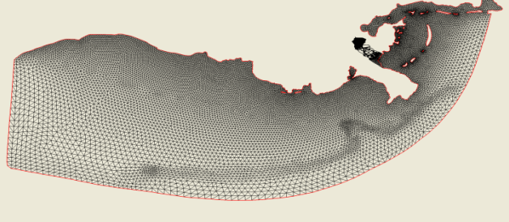
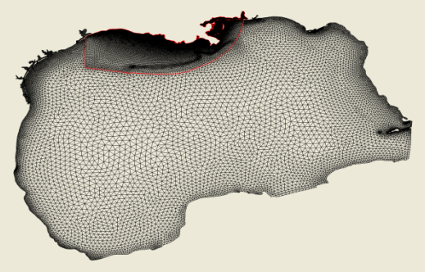
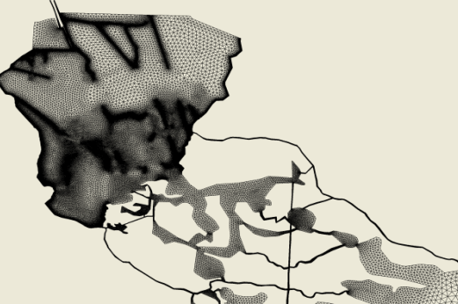

Hierarchical Meshes
One vertex may be covered by multiple refinement levels – multiresolution methods
Nested triangular grids for the La-Tex continental shelf (upper panel, Wang and Justic, 2009), the Breton Sound estuary (lower right panel, Huang et al., 2011) and (lower left) the Gulf of Mexico model.
Block-structured adaptive mesh refinement grid (AMR)

Slide 89
Hierarchical Skeletons
Third identification parameter on Skeletons:
“refinement” (integer valued or n-dimensional set of integer valued group attribute)
Allows to formulate “a grid within a grid”
Replicates topological structure on different refinement levels

Slide 90
Skeletons as Fibers of a 3-dimensional parameter space
Refinement
Index Depth
Dimensionality

Slide 91
Skeletons as Fibers of a 3-dimensional parameter space
Refinement
Index Depth
Vertices
Dimensionality

Slide 92
Skeletons as Fibers of a 3-dimensional parameter space
Refinement
Index Depth
Groups of Vertex
Selections
Sets of Edges
(Lines)
Sets of Faces
(Surface Regions)
Sets of Cells
(Blocks)
Vertex
Selection
Edges
Faces
Cells
Vertices
Dimensionality

Slide 93
Skeletons as Fibers of a 3-dimensional parameter space
1st
refinement
Level
Groups of Vertex
Selections
Sets of Edges
(Lines)
Sets of Faces
(Surface Regions)
Sets of Cells
(Blocks)
Vertex
Selection
Edges
Faces
Cells
Vertices
Index Depth
Refinement
Groups of Vertex
Selections
Sets of Edges
(Lines)
Sets of Faces
(Surface Regions)
Sets of Cells
(Blocks)
Vertex
Selection
Edges
Faces
Cells
Root
Level
Vertices
Dimensionality

Slide 94
Relative Representations as Connectors between Skeletons
1st
refinement
Level
Groups of Vertex
Selections
Sets of Edges
(Lines)
Sets of Faces
(Surface Regions)
Sets of Cells
(Blocks)
Vertex
Selection
Edges
Faces
Cells
Vertices
Index Depth
Refinement
Groups of Vertex
Selections
Sets of Edges
(Lines)
Sets of Faces
(Surface Regions)
Sets of Cells
(Blocks)
Vertex
Selection
Edges
Faces
Cells
Root
Level
Vertices
Dimensionality

Slide 95
Inter-Grid Relationships
Representations may refer to Skeletons within another Grid:
/T=0/FirstGrid/Points/CartesianChart3D/Positions {float x,y,z} Dataset {1000}
/T=0/SecondGrid/Points/CartesianChart3D/Positions {float x,y,z} Dataset {100}
?

Slide 96
Inter-Grid Relationships
Use index fields/bitmaps when points match exactly:
Utilizes HDF5 symbolic links
/T=0/FirstGrid/Points/CartesianChart3D/Positions {float x,y,z} Dataset {1000}
/T=0/FirstGrid/Points/SecondPoints/Positions {bitmap} Dataset {1000}
Representer → /T=0/SecondGrid/Points
/T=0/SecondGrid/Points/CartesianChart3D/Positions {float x,y,z} Dataset {100}
/T=0/SecondGrid/Points/FirstPoints/Positions {int index} Dataset {100}
Representer → /T=0/FirstGrid/Points

Slide 97
Inter-Grid Relationships
Use interpolation weights and indices when points do not match exactly:
Allows to evaluate any field on FirstGrid on SecondGrid (and vice versa)
/T=0/FirstGrid/Points/CartesianChart3D/Positions {float x,y,z} Dataset {1000}
/T=0/FirstGrid/Points/SecondPoints/Positions {int [];} Dataset {1000}
Weights {float [];} Dataset {1000}
Representer → /T=0/SecondGrid/Points
/T=0/SecondGrid/Points/CartesianChart3D/Positions {float x,y,z} Dataset {100}
/T=0/SecondGrid/Points/FirstPoints/Positions {int [];} Dataset {100}
Weights {float [];} Dataset {100}
Representer → /T=0/FirstGrid/Points

Slide 98
Temporal Relationships
Representations may refer to Skeletons of the same Grid on different times:
Allows to trace the evolution of features
Timelike derivatives, …
/T=0/FirstGrid/Points/CartesianChart3D/Positions {float x,y,z} Dataset {1000}
/T=0/FirstGrid/Points/SecondPoints/Positions {int [];} Dataset {1000}
Weights {float [];} Dataset {1000}
Representer → /T=1/FirstGrid/Points
/T=1/FirstGrid/Points/CartesianChart3D/Positions {float x,y,z} Dataset {100}
/T=1/FirstGrid/Points/FirstPoints/Positions {int [];} Dataset {100}
Weights {float [];} Dataset {100}
Representer → /T=1/FirstGrid/Points

Slide 99
Partial Time Dependence
Application Scenario:
Curvilinear Grid with vector field
Coordinates do not vary over time
Dynamic Vector field, changes each time step
Utilizes HDF5 symbolic links
Any application operation on dynamic data can read partially time-dependent data as well
Any field can be defined time-independent, for all time steps, or just some time interval
/T=0/MyGrid/Points/CartesianChart3D/Positions {float x,y,z} Dataset {10,10,10}
/T=0/MyGrid/Points/CartesianChart3D/Vectorfield {float dx,dy,dz} Dataset {10,10,10}
/T=1/MyGrid/Points/CartesianChart3D/Positions → /T=0/MyGrid/Points/CartesianChart3D/Positions
/T=1/MyGrid/Points/CartesianChart3D/Vectorfield {float dx,dy,dz} Dataset {10,10,10}

Slide 100
Summary
The F5 model avoids “keyword” conventions as much as possible
Semantic information is cast into the structure of the file instead of relying on naming conventions (enumeration approach, registries, naming standards…)
Interpretation of data fields is based on placement of data sets in the hierarchy
Internal layout is not 100% keyword-free, but as widely as possible
Some keywords will become obsolete with future advancements of HDF5 (e.g., shared dataspaces)

Slide 101
Conclusion
Commonalities across Grid types are not just enabled, they are unavoidable
Simple data types have simple representations
Complex data types are constructible from similar, reusable structures
The F5 model does not cover any type of data, but a very wide range
Certain aspects of the F5 model leave space for further refinement and definition how to interpret things

Slide 102
F5 API
Implementation Design & Concepts

Slide 103
Design of the F5 Library
API similar to HDF5
Expose HDF5, not hiding it
Use as much of HDF5 as possible
Upgrade to future HDF5 functionality once available
Emulate future HDF5 functionality in the meanwhile

Slide 104
Design of the F5 Library
3 categories of API functions:
Internal API
Common functions to share logistics
Low-Level API
Access to all constructions elements constituting the F5 formulation
High-Level API
Simple, “one-call” functions covering frequently asked cases

Slide 105
F5Path object
Central object for user-accessible operations
This structure contains all HDF5 identifiers that describe a path in an HDF5 file towards a field structure.
/Time/Grid/Top/Rep/Field/Fragment
hid_t hid_t hid_t hid_t hid_t hid_t

Slide 106
Example: API levels
F5Lwrite(hid_t R_id, const char*fieldname, int dimension, const hsize_t*dims, hid_t fieldtype, hid_t memtype, const void * dataPtr, hid_t enum_type, hid_t property_id);
F5Fwrite(F5Path*fpath, const char*fieldname, int dimension, hsize_t*dims, hid_t fieldtype, hid_t memtype, const void * dataPtr, hid_t property_id)
F5Fwrite_uniform_cartesian3D(hid_t file_id, double time, const char*gridname, const F5_vec3_point_t*origin, const F5_vec3_float_t*spacing, hsize_t dims[3], const char*fieldname, hid_t fieldtype, const void * dataPtr, const Char*coordinate_system,hid_t property_id);

Slide 107
F5F.h
User Field Access Functions
e.g.:
F5Fwrite(F5Path*fpath, const char*fieldname, int dimension, hsize_t*dims, hid_t fieldtype, hid_t memtype, const void * dataPtr, hid_t property_id);
Uses F5Path object to write HDF5 data to the right location
Passes HDF5 information to the right location
Performs additional semantic checks beyond HDF5 – dataspace consistent

Slide 108
F5L.h
Internal low-level field functions
E.g.:
F5Lwrite(hid_t R_id, const char*fieldname, int dimension, const hsize_t*dims, hid_t fieldtype, hid_t memtype, const void * dataPtr, hid_t enum_type, hid_t property_id);
Merely uses HDF5 identifiers
Creates HDF5 dataset with attributes as interpreted by HDF5
Caller must know exact location

Slide 109
Groups of Functions
F5Bchart.h
coordinate systems, charts
F5AMR.h
adaptive mesh refinement
F5uniform.h
Uniform meshes
…

Slide 110
The End
http://www.hdfgroup.org
http://www.fiberbundle.net
http://sciviz.cct.lsu.edu/projects/vish/
http://f5.origo.ethz.ch

